Slide 1


Slide 2


Slide 3
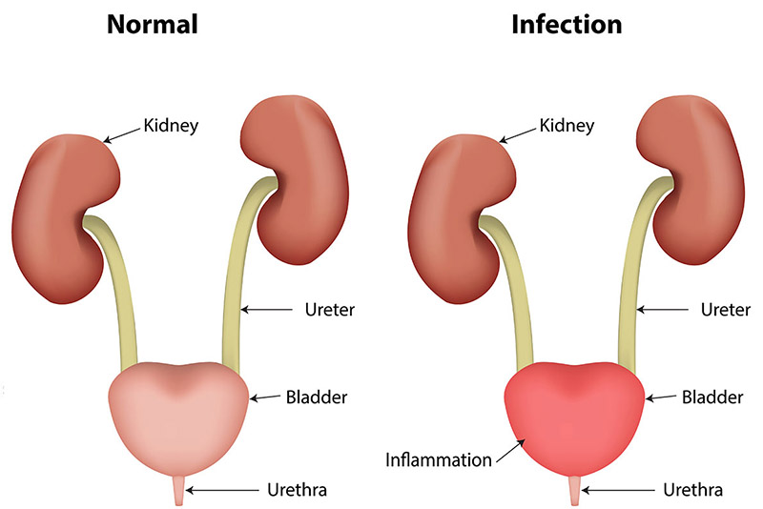

Slide 4
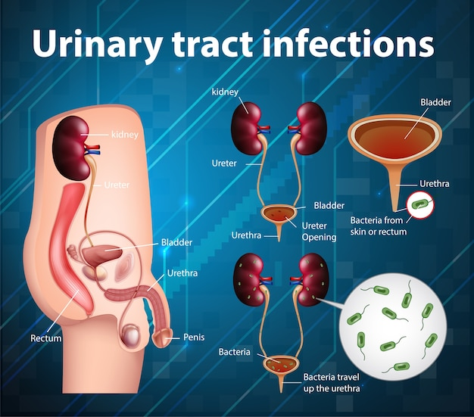
Prepared by:
Bandana Tiwari
Roll no: 6
BNS 2nd year

Slide 5
GENERAL OBJECTIVES
At the end of the classroom session, BNS 1st year students will be able to explain about urinary tract infection and chronic kidney disease.

Slide 6
SPECIFIC OBJECTIVES
At the end of this teaching session, the BNS 1st year students will be able to :
define urinary tract infection
list the risk factors of urinary tract infection
state the signs and symptoms of urinary tract infection
enlist the diagnostic investigation of urinary tract infection
explain the treatment procedure of urinary tract infection
explain the nursing management of urinary tract infection

Slide 7
Cont..
enlist the complication of urinary tract infection
explain the prevention of urinary tract infection
define chronic kidney disease
state the stages of chronic kidney disease
list the causes of chronic kidney disease
state the signs and symptoms of chronic kidney disease
enlist the diagnostic investigation chronic kidney disease
explain the treatment procedure of chronic kidney disease
explain the nursing management of chronic kidney disease
List the prevention of chronic kidney disease

Slide 8

URINARY TRACT INFECTION

Slide 9
INTRODUCTION
Urinary tract infection is an infection of the urinary tract.
The infection can occur at different points in the urinary tract including:
Bladder: an infection in the bladder is also called cystitis or bladder infection

Slide 10
Cont..
Kidneys: an infection of one or both kidneys is called pyelonephritis or kidney infection.
Ureters: the tubes that take urine from each kidney to the bladder are only rarely the site of infection.
Urethra: an infection of the tube that empties urine from the bladder to the outside is called urethritis.

Slide 11
RISK FACTORS
Intercourse
Obstruction the flow of urine
Gender
Urinary catheter

Slide 12
Cont..
Poor hygiene practices
Diabetes
Urinary retention

Slide 13
SIGN AND SYMPTOMS
Cloudy urine
Bloody urine
Strong or foul – smelling urine odor
Frequent or urgent need to urinate

Slide 14
Cont..
5) Pain or burning with urination
6) Pressure in the lower pelvis
7) Low grade fever
8) Night sweats, shaking or chills

Slide 15
DIAGNOSTIC EVULATION
History taking
Physical examination
Urinalysis

Slide 16
Cont..
Clean catch urine culture
Blood test
Kidney scan

Slide 17
TREATMENT
Medical treatment :
Antibacterial drugs ( amoxicillin , doxycycline)
Analgesic

Slide 18
NURSING MANAGEMENT
Asses the patient voiding patterns.
Assess the urine color , amount and odor.
Assess the patient pain.
Encourage patient to drink fruit juice.

Slide 19
Cont..
Apply heating pad to relieve pain .
Encourage warm showers.
Encourage to maintain perineal hygiene .
Voiding habits : void in every 2-3 hrs.

Slide 20
Cont..
Administer analgesic as prescribed.
Teach patient about non medical treatment: maintenance of hygiene , rest ,plenty of fluid.

Slide 21
COMPLICATION
Sepsis
Kidney infection
Kidney damage

Slide 22
PREVENTION
Cleaning genital areas daily .
Drink plenty of water every day.
Urinate when feel the need , don’t resist the urge to urinate .

Slide 23
Cont..
4. Wipe from front to back to prevent bacteria around the anus from entering the vagina or urethra.
5. Take showers instead of tub baths.
6. Avoid using feminine hygiene sprays and scented douches, which may irritate the urethra.

Slide 24
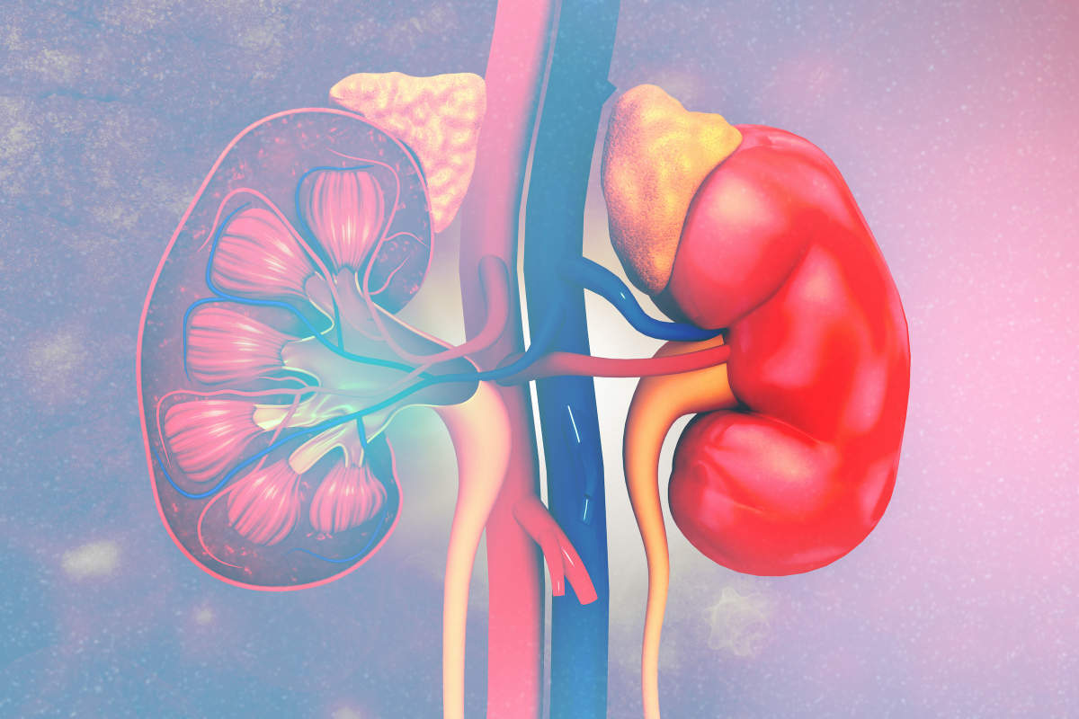

Slide 25
CHRONIC KIDNEY DISEASE (CKD)
Chronic kidney disease is based on the presence of kidney damage or decrease kidney function (i.e, glomerular filtration rate <60ml / minute per 1.73m2) for three months or more, irrespective of clinical diagnosis ( levey and coresh , 2012).

Slide 26
Cont..
It is a serious condition associated with decreased quality of life , and increased health- care expenditures.
Kidney disease is often silent and occurs when the nephrons, which are the tiny blood filtering units of the kidney, become damaged.

Slide 27
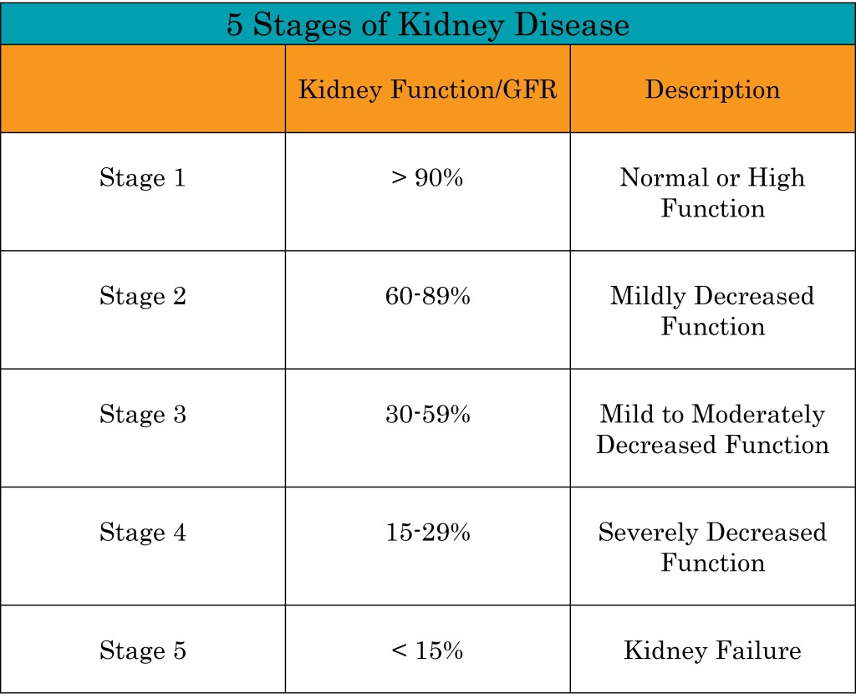
STAGES OF CHRONIC KIDNEY DISEASE BY NEPH CARE KIDNEY INTERNATIONAL

Slide 28
CAUSES
Diabetes : common
High blood pressure
Ageing kidneys
Glomerulonephritis

Slide 29
Cont..
Renal artery stenosis
Polycystic kidney disease

Slide 30
SYMPTOMS
Hypertension
Change in frequency of urination
Hematuria
Edema
Back pain

Slide 31
Cont..
Headache
Fatigue
Loss of appetite
Sleep disturbance
Shortness of breath

Slide 32
DIAGNOSTIC EVALUATION
History taking
Physical examination
Blood test

Slide 33
Cont..
Urine test
Kidney biopsy
Ultrasound
CT scan

Slide 34
TREATMENT
Proper diet (fluid and sodium restriction)
Medication (antihypertensive )
Dialysis
Transplantation
Conservative care

Slide 35
NURSING MANAGEMENT
Assessment
Take complete history
Look closely for risk factors
Assess for the multiple effects on all body systems

Slide 36
Cont..
Assess patient’s and family understanding the diagnosis , involve them to cope with the disease and treatment planning.

Slide 37
NURSING DIAGNOSIS
Excess fluid volume related to inability to secret urine.
Imbalanced nutrition: less than body requirement.
Deficient knowledge regarding condition and treatment regimen.

Slide 38
Cont..
Infection related to immunosuppressant.
Low self- esteem related to dependency , role changes in body image and sexual dysfunction.

Slide 39
NURSING IMPLEMENTATION
Assess fluid status, help patient limit intake to prescribed limit.
Maintain adequate nutritional intake.
Assess the patients knowledge , identify ways to incorporate lifestyle change related to illness.
Assess factors contributing to fatigue.

Slide 40
Cont..
Assess self- esteem, family’s responses and reaction to illness and treatment.
Monitor collaborative problems: hyperkalemia, pericarditis, hypertension, anemia and bone disease.
Prepare patient’s and family emotionally.

Slide 41
Cont..
Monitor vital signs and intake and output.
Provide skin care .
Weight the patient before and after procedure .
Provide care for the patient undergoing dialysis.

Slide 42
PREVENTION
Blood pressure checked regularly.
Control of diabetes.
Be careful about taking non prescription medications, particularly painkillers.

Slide 43
Cont..
4. Low salt diet.
5. Stop smoking
6. Reduction of weight
7. Timely blood test and urinalysis

Slide 44


Slide 45


Slide 46
POST TEST
Fill in the blanks (1*1=1)
The infection of one or both kidney is called …
Urethritis
Pyelonephritis
Cystitis
Bladder infection

Slide 47
Cont..
2) True or false (2*1=2)
In chronic kidney disease the glomerular filtration rate is > 60 ml per minutes .
(False)
b) Urinary tract infection can cause frequent need to urinate.
(True)

Slide 48
ASSIGNMENT
What do you understand about urinary tract infection . Write it’s preventions .
What do you understand about chronic kidney disease . State it’s stages and write it’s nursing management.

Slide 49
PLAN FOR NEXT CLASS
We will discuss about geriatric emergencies .

Slide 50
REFERENCES
K.C, T, & Rai, B, (2019). A Textbook of Geriatric Nursing. (3rd ed). Heritage publisher and distributors.
Subbha.K,H & Subedi, P,S,(2019). A Textbook of Geriatric Nursing. (1st ed). National book centre.
Baral.R, Essential of Geriatric Nursing. Makalu publication.
Pradhan.M,K & Roka, A,T.(2015). Gerontological Nursing for BN/BSN Students. (1st ed) Vidyarthi publication.
Timalsina,R, (2020). Comprehensive Textbook of geriatric Nursing (3rd ed). Samiksha publication.

Slide 51


